Slide 1

Project 1 Spotify Song Attributes Analysis

Slide 2

In this project we will answer the following questions
Which songs are liked, and which songs are not?
Who is the most popular artist?
Does danceability make an artist more popular?
Does the duration of the song affect the likeability of a song?
How does the energy affect the likeability of a song?

Slide 3

Introduction
Overview
Objectives
Data Source
Methodology
Data Visualization
Final tips & takeaways

Slide 4
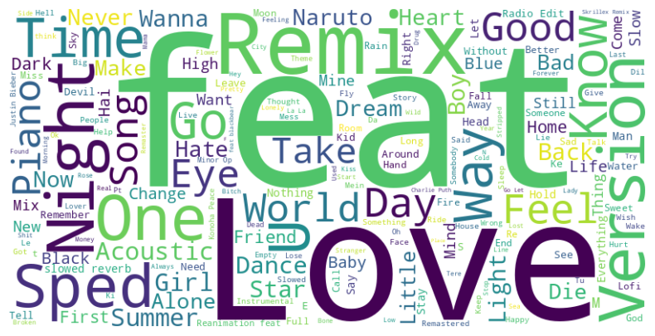
Introduction Our interest in this project comes from our curiosity on how some attributes such as “Danceability, Tempo and Energy “ could affect the music preferences of the audience.

Slide 5

Overview The Spotify Song Attributes Analysis Project aims to explore and analyze the various attributes of songs available on Spotify. This project will provide insights into the factors that influence song popularity and artists popularity.

Slide 6

Objectives
Analyze the distribution and trends of song attributes such as Danceability, Energy, Tempo, and more.
Identify the key attributes that contribute to song popularity.
Data visualization of the relationships between different song attributes and their impact on popularity.

Slide 7

Data Source
We use the Spotify Song Attributes dataset available on Kaggle (Spotify Song Attributes Analysis 🎶)

Slide 8

Methodology
Data Collection
Data Cleaning
Data Analysis
Data Visualization

Slide 9

Data Collection
Download the dataset from Kaggle.
Perform initial data exploration to understand the structure and contents of the dataset.

Slide 10

Data Cleaning
Handled missing values and duplicates.
Standardize data formats and ensure consistency across features

Slide 11
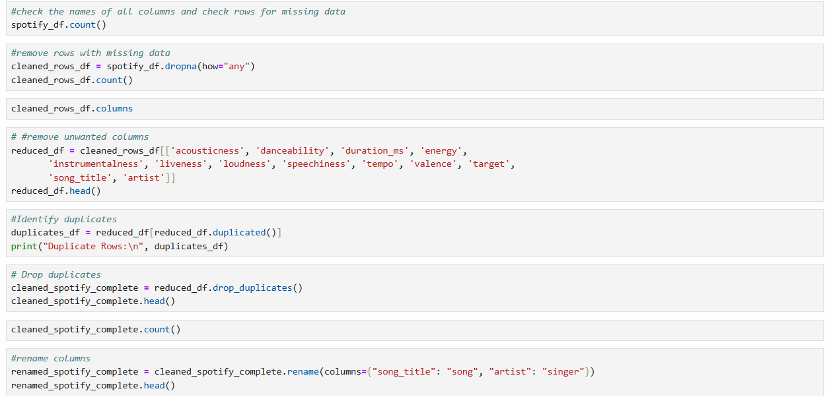
Data Cleaning

Slide 12

Data Analysis & Data Visualization
We will be presenting data in a visual format, such as charts, graphs, to make it easier to understand. The goal of data visualization is to communicate the insights found in the data to a range of audiences.

Slide 13
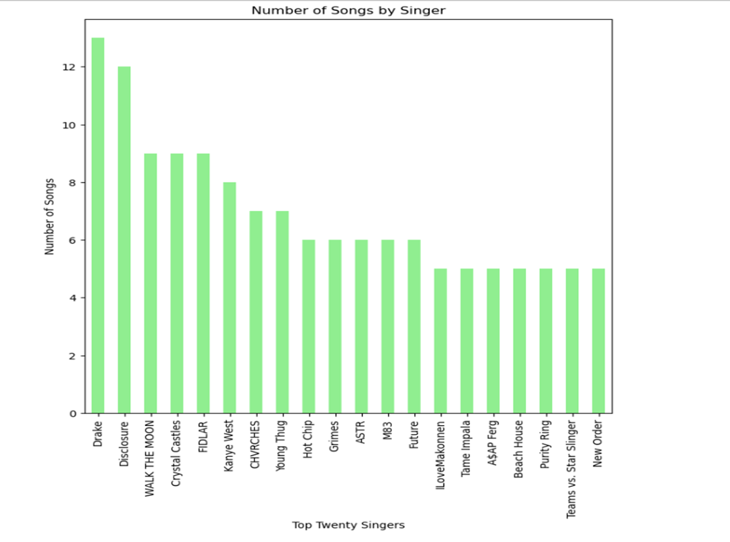
Data Visualization / Bar Chart
Drake is the most popular artist in the collection with 13 songs.
Disclosure came in a close second with a total of 12 songs in the dataset collection.

Slide 14
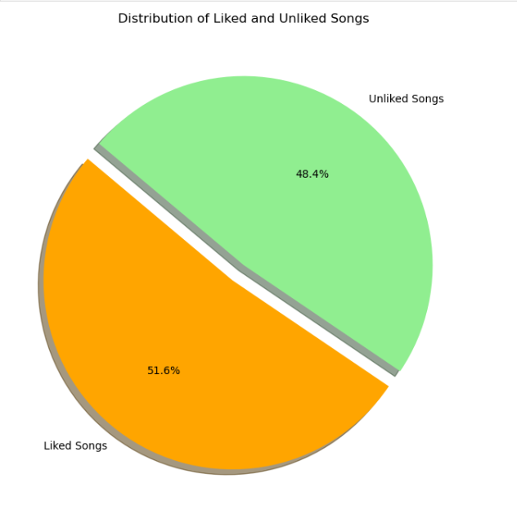
Data Visualization / Pie Chart
Overall, the two categories were almost evenly distributed, presenting a pie chart graph with 51.6% liked songs and 48.4% of songs disliked……………

Slide 15
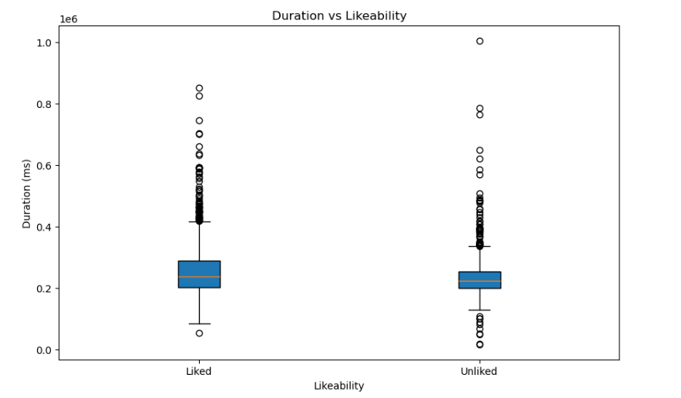
Data Visualization / Box Plot
The Box Plot indicates that liked songs generally have a higher median duration than unliked songs. Moreover, the duration of liked songs is more spread out, suggesting more variability.
Both liked and unliked songs have a considerable number of outliers, reflecting songs with significantly longer durations.

Slide 16
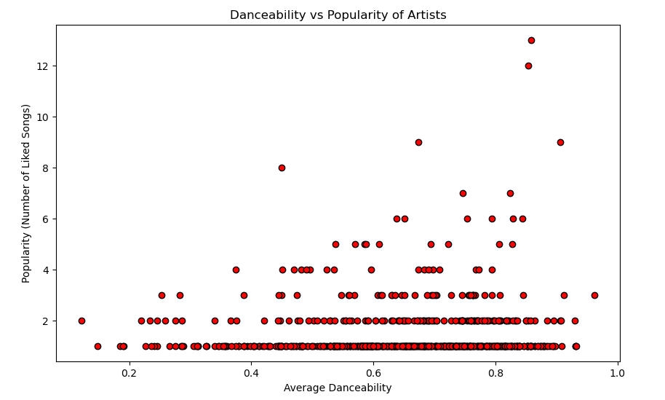
Data Visualization / Scatter Plot
The scatter plot suggests that there is a tendency for the Artist with songs that has higher average danceability to be more liked than the ones with lower average danceability.

Slide 17
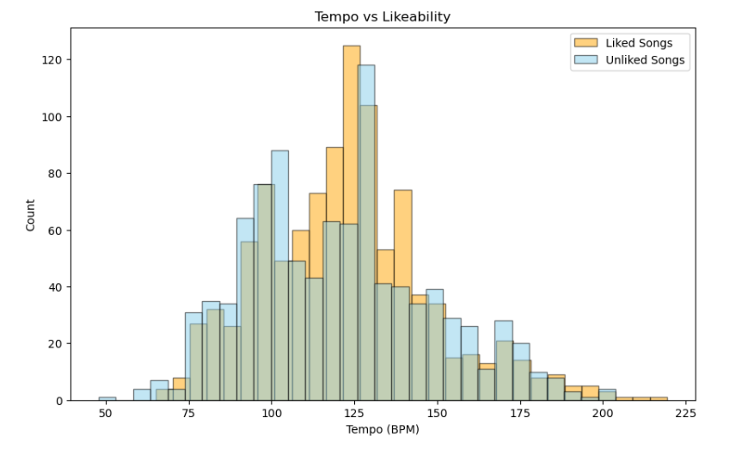
Data Visualization / Histogram
This histogram illustrate the effects of Tempo and its correlation to liked and unliked songs.
The Tempo ranges from approximately 110–130 BPM in the histogram. Liked songs fall in the range of 120–125 BPM, suggesting that songs in this tempo range are generally more liked

Slide 18
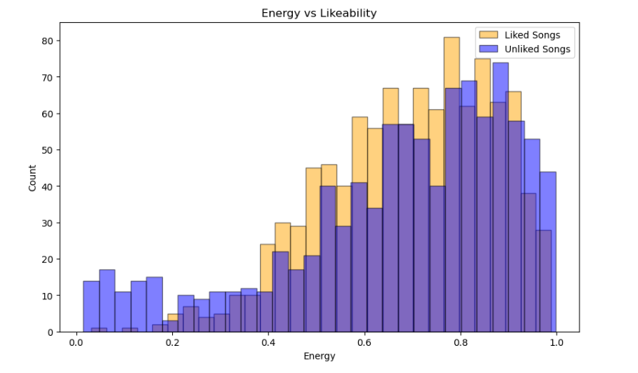
Data Visualization / Histogram
This histogram illustrate the effects of Energy and its correlation to liked and unliked songs.
Energy values range from 0.0 (low energy) to 1.0 (high energy). Liked songs are more prominent in the energy range 0.6 to 0.9, this explains that users tend to like songs with moderately high energy levels. Unliked songs stand out in the range 0.2 to 0.5, showing that songs with lower energy levels may be more unliked

Slide 19

Final tips & takeaways
In conclusion:
This analysis provides valuable insights into the factors influencing the likeability and popularity of songs. The dataset revealed a nearly even distribution between liked and unliked songs, with liked songs slightly outnumbering unliked ones. Drake emerged as the most popular artist, closely followed by Disclosure, demonstrating their strong presence in the dataset.
Danceability appears to have a slight positive correlation with popularity, as artists with more danceable music often had more liked songs.
Similarly, song duration plays a role, with longer songs generally being more liked, although exceptions exist.
Energy and Tempo also contribute to likeability, with liked songs often featuring moderately high energy (0.6–0.9) and tempos in the 120–125 BPM range. These findings emphasize how various attributes influence audience preferences, offering a foundation for deeper exploration into what makes music resonate with listeners.

Slide 20
Thank you
Tyquese Taplin
Fitsum Metaferya
Michel Kamankenda-Tshilumba

